Slide 1
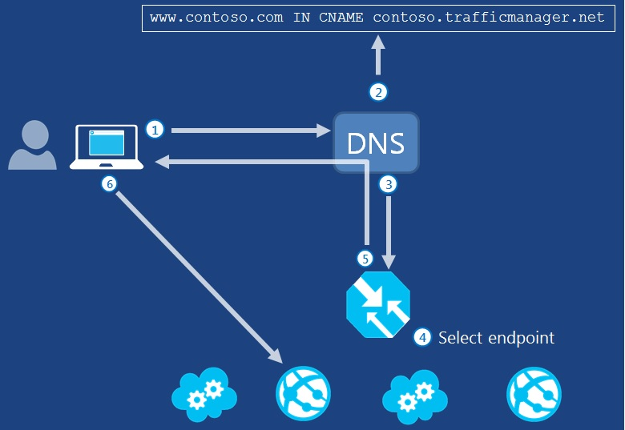
Traffic Manager
Balance method
Performance
Round ribbon
failover
TTL
Probe
Notes:
http://mxtoolbox.com/SuperTool.aspx?action=a%3aecoauthz.trafficmanager.net&run=toolpage#

Slide 2
Service Fabric

Slide 3
Service Fabric
A cluster Orchestration
Manage Application lifecycle (deploy/upgrade/failover/scale/balance/…)
Able to run both stateless and stateful microservice
Can be hosted on anywhere (Azure, Private DC, Partner DC, Windows/Linux)
GA H1 2016
Notes:
Demo

Slide 4
Cluster Orchestration
Web Apps
Mobile
Apps
Media
App Service
CloudFoundry
ACS
VMSS
Service Fabric
(VMs and Containers)
Cluster Orchestration
VM Extensions
IaaS and IaaS+
VMs and VM Scale Sets
Infrastructure
Azure Stack
Azure Public Cloud
Notes:
Demo: show azure portal and FS portal

Slide 5
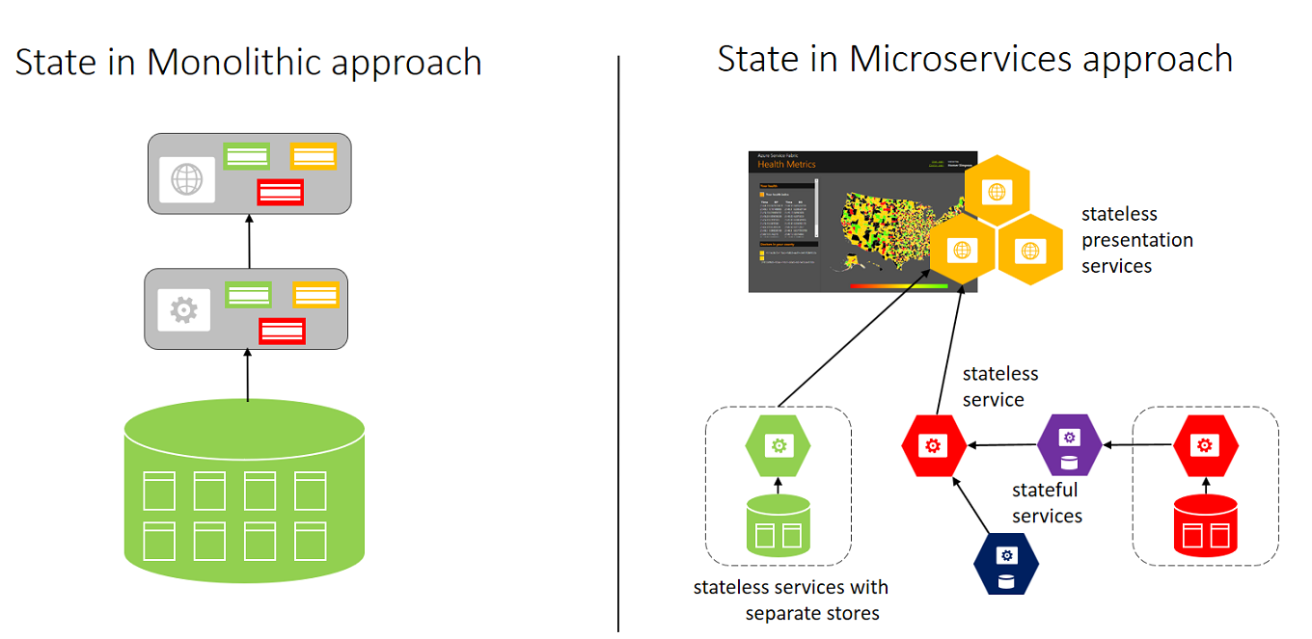
Microservice
Microservice applications are composed of small, independently versioned, and scalable customer-focused services that communicate with each other over standard protocols with well-defined interfaces.

Slide 6
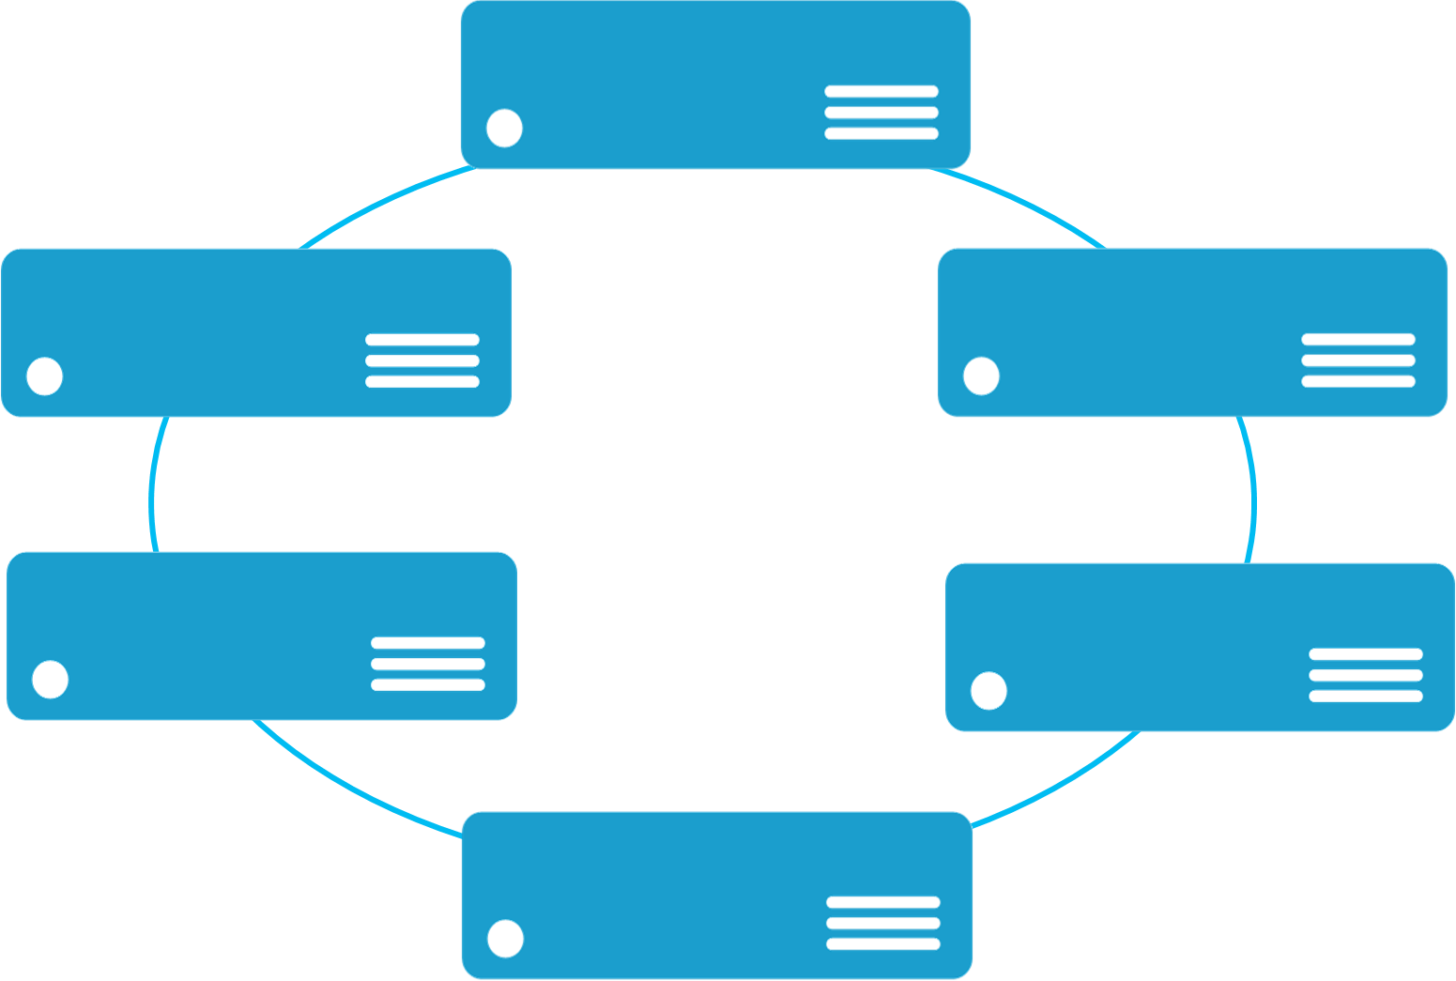
Application lifecycle
Deploy
Upgrade
Failover (test)
Scale
Balance
APP
FS Mgmt API
Cluster Infra Service
Notes:
Show FS portal
http://keystone2.westus.cloudapp.azure.com:19080/Explorer/index.html

Slide 7
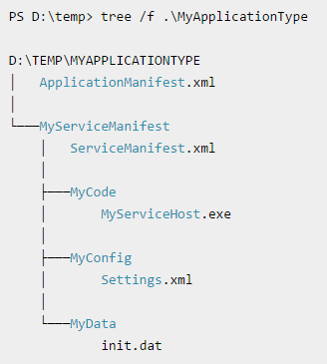
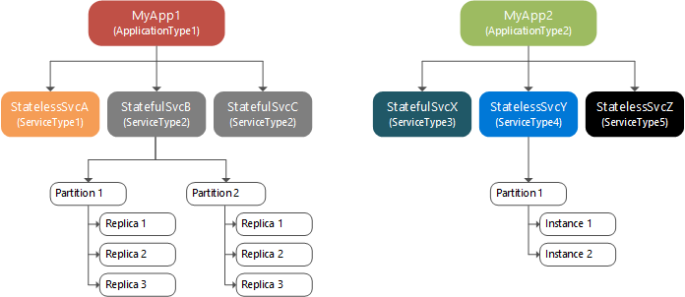
Application format
Application are a group of services
Service unit: .exe, jvm, windows container (plan)
ServiceManifest.xml describe service
ApplicationManifest.xml describe Application

Slide 8
Programming Model
Reliable Service
Stateless
Stateful
Reliable Actor
Stateless
Stateful

Slide 9
Replication/Partition
Services can be partitioned for scale-out
Each partition replicates to keep HA
Node 1
Node 2
Node 3
Node 4
Node 5
Node 6
S
P2
P1
S
S
S
S
P3
P4
S
S
S
Stateless
Stateless
Stateless
Stateless
Stateless
Stateless
Notes:
Raft
https://raft.github.io/
demo
http://thesecretlivesofdata.com/raft/

Slide 10
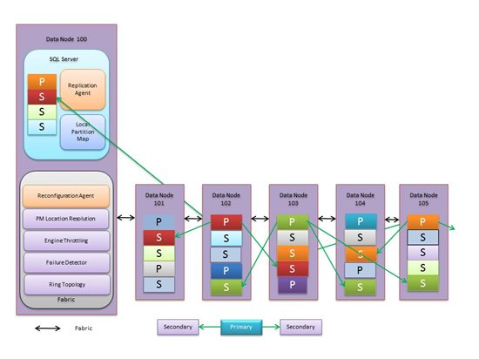
Azure SQL Architecture

Slide 11
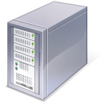
Azure Storage Stamp Architecture
Ack
Incoming Write Request
Front End Layer
FE
FE
FE
FE
FE
Partition
Master
Lock Service
Partition Layer
Partition
Server
Partition
Server
Partition
Server
Partition
Server
M
Stream
Layer
M
Paxos
M
Extent Nodes (EN)

Slide 12
Host on anywhere
Microservices
High Availability
Data Partitioning
Service Fabric
Health Monitoring
Container Orchestration & lifecycle management
Hybrid Operations
Self-healing
Simple programming models
High Density
Rolling Upgrades
Low Latency
Placement Constraints
Replication & Failover
Fast startup & shutdown
Resource balancing
Hyper-Scale
Automated Rollback
Stateful services
Azure
Private cloud
Other clouds

Slide 13
Telemetry
Cluster State
Health report
Log
Windows Event Log & Performance counter
WAD Extension(Windows Azure Diagnostic)

Slide 14
Consideration
SF not support System.Web and IIS dependencies
Support for ASP.NET 5 – Open Source Stack
Still in public preview, lack of resource, SDK is unstable. Potential high maintenance work.

